Slide 1
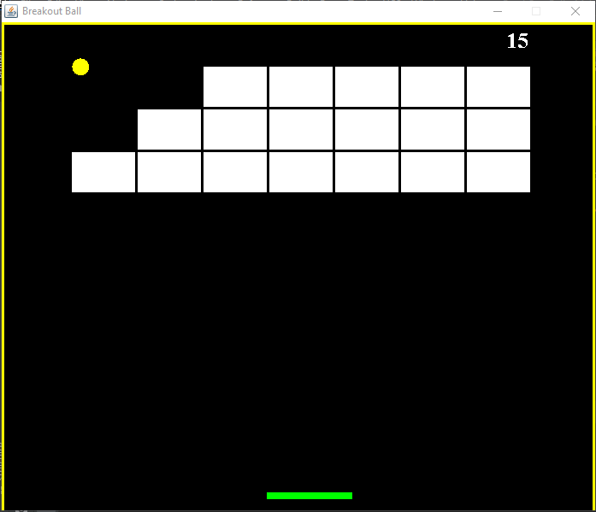

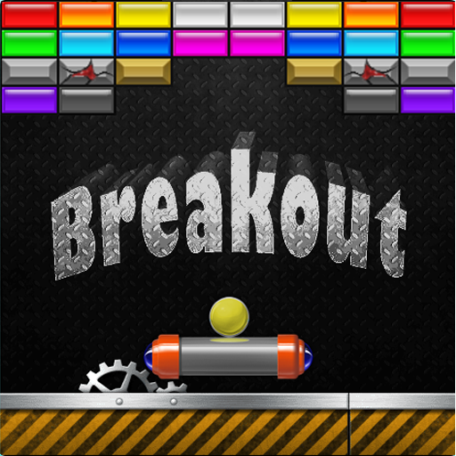
Breakout Ball

Slide 2
Overview:
Objective:
Java is widely used by game development companies and for creating mobile games. And this fact shouldn’t come as much of a surprise, given how versatile the language is and given its rich collection of open-source material. Many of the world’s top mobile games have been developed in Java. Minecraft, Mission Impossible III, and Asphalt 6 are just a few popular names you are probably familiar with. We will be creating a game using new java concepts like AWT, Swing etc.
.

Slide 3
Project Context:
Breakout Ball game is a widely used game which was developed in the 1970s. In Breakout, a layer of bricks lines the top third of the screen and the goal is to destroy them all. A ball moves straight around the screen, bouncing off the top and two sides of the screen. When a brick is hit, the ball bounces back and the brick is destroyed. The player loses a turn when the ball touches the bottom of the screen; to prevent this from happening, the player has a horizontally movable paddle to bounce the ball upward, keeping it in play. The player uses the platform to keep the ball running. The goal is to break the bricks without missing the ball with your platform. The project makes use of Java swing, OOPS concepts and much more.
Here, you will use new java concepts of beginner level (AWT, Swing, JFrame, JPanel etc). This game is not meant to be the next most sold game but just a platform from which to learn and maybe inspire someone to be the next most successful developer in the world ;)

Slide 4
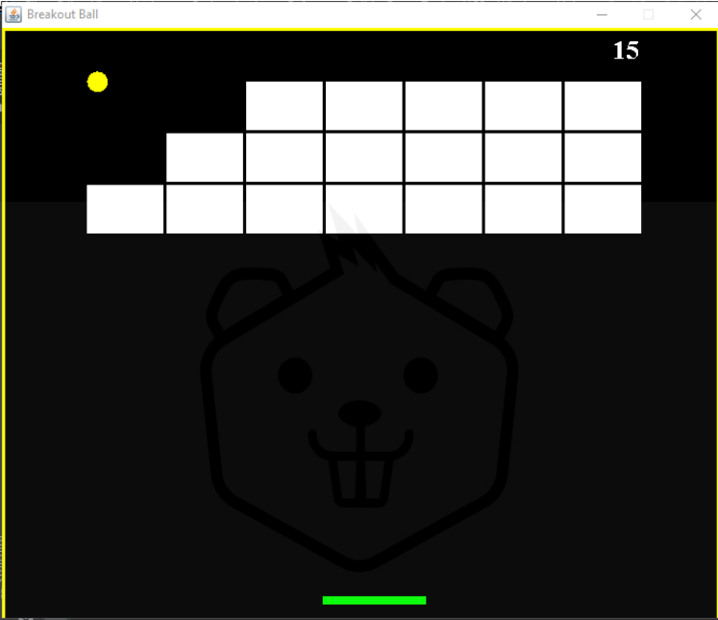
An instance of the game in action:

Slide 5
Project Stages:
The product Architecture can be divided into 5 stages as follows:
1. Create a Java project using Command Line App.
2. Design the project structure.
3. Once the project is set, design the window terminal frame.
4. Design the entire background by setting the dimensions, colour, focus and object count.
5. Implement the actions of the keys and the objects.

Slide 6
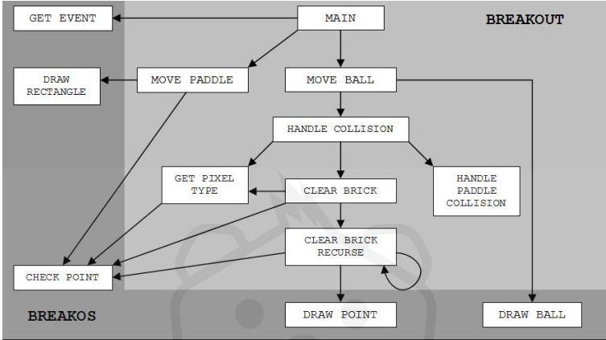
Breakout Ball game architecture diagram:

Slide 7
High-Level Approach:
Design the window where the game needs to be framed.
2. Design the entire gameplay (background, bricks, ball, paddle).
3. Implement the actions of the keys (to move the paddle sideways).
4. Implement the action performed by the ball on the bricks and paddle
Primary goals:
The player should be able to start the game in the terminal by pressing the ENTER key.
The player should be able to move the paddle sideways using the Leftwards and the Rightwards Arrow on the keyboard.
3. Once the player loses the ball, i.e. when the ball touches the bottom of the screen, the game ends.

Slide 8
4. Breaking each brick should provide the player a certain number of points. Let's say each brick contains 5 points, if a player breaks 10 such bricks, he gets 50 points.
5. Once the game ends, the terminal will present the final score of the player and give him the option to restart the game again.

Slide 9
Task 1:
Setting up the development environment:
First you need to set up the development environment for the Java GUI project. For this, you need to install Java 8 or higher. Additionally you need a code-editor or IDE to write the code.
Requirements:
Install Java (JDK 1.8)
2. Install any IDE- IntelliJ (Community edition) or Eclipse or VS Code
3. Do the environment setup for Java on your local machine
4. Create a Java project using Command Line App as the template
5. Provide the project name and the base package

Slide 10
Check the version of java to know whether you have successfully installed it or not
Congratulations!!! Your initial set up is done!

Slide 11
Task 2
Design the Game terminal
Game terminal is the window where the game is to be played. It consists of the following aspects: - Window size (length, breadth and height) - Window visibility - Game title - Default close operation
Requirements
Create a Main class inside the base package
2. Import Java Swing dependency
3. Create a JFrame object to implement the GUI functionality
4. Design the window terminal by writing your code
Congratulations!!! You have successfully designed the game terminal!

Slide 12
Task 3
Design the gameplay
Game design sits under the broader field of game development and refers to the use of creativity and design to develop a game for entertainment or educational purposes. Games can be characterized by "what the player does" and "what the player experiences". This is often referred to as gameplay.
Gameplay design is responsible for the central part of the game experience – how it plays. It plans and defines the game’s structure, its rules, characters, objects, props and thinks about different modes of play

Slide 13
Requirements
Create a Gameplay class inside the base package
2. Import Java AWT and Swing dependencies
3. Extend the JPanel container class by implementing KeyListner and ActionListner interfaces. Check out more on these classes and interfaces:
● JPanel ● ActionListner ● KeyListner
4. Design the background template
5. Implement the code for ball positioning
6. Implement the code for moving the paddle using KeyEvent and ActionEvent
Congratulations!!! You have successfully designed the gameplay!

Slide 14
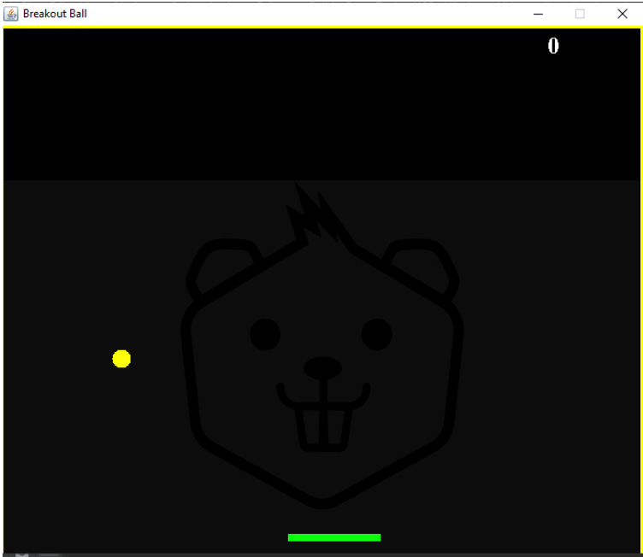
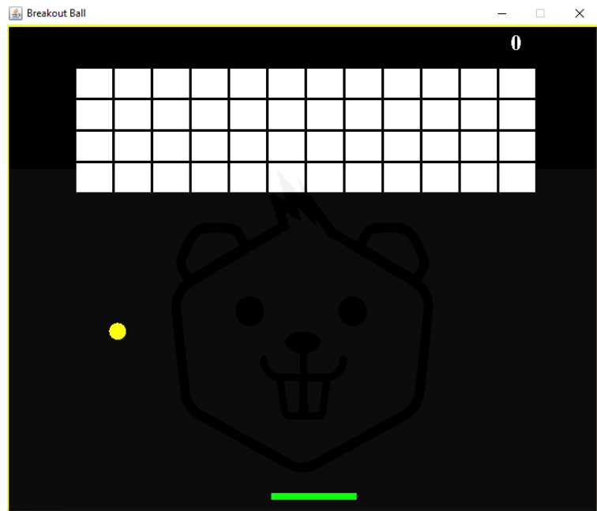

Slide 15
Task 5
Run the game in the terminal
Wrap up the code of the game and start it off right away using the terminal directly.
Requirements
Build the project
2. Import any dependencies, if left
3. Run the Main() class
4. Play the game in the terminal
Congratulations!!! You have successfully started your game!

Slide 16

Thank You!
someone@example.com

